Slide 1


MOOC SEMINAR PRESENTATION ON ANDROID DEVELOPMENT
Name :- Devansh Rautela
Section :- C
Semester :- 5
Roll No :- 20
Student ID :- 200111158
University Roll No :- 2018314
PRESENTED TO :- Mr. Sameer Rana

Slide 2
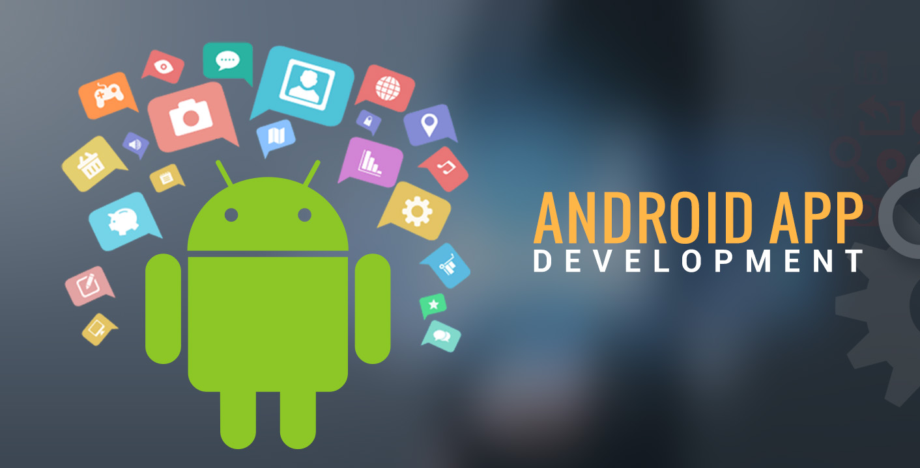

Slide 3
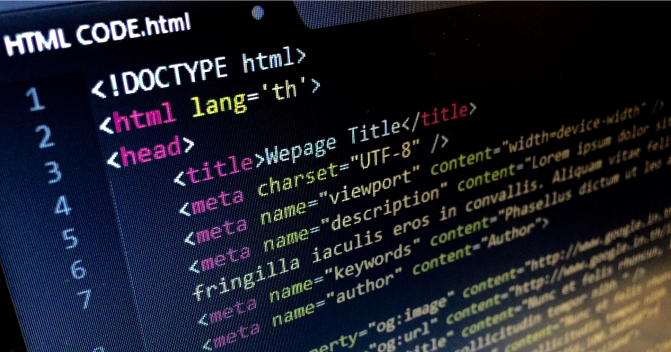
TABLE OF CONTENT
What is android development?
Languages used
Android market
Environment SETUP
CHALLENGES FOR DEVELOPERS

Slide 4
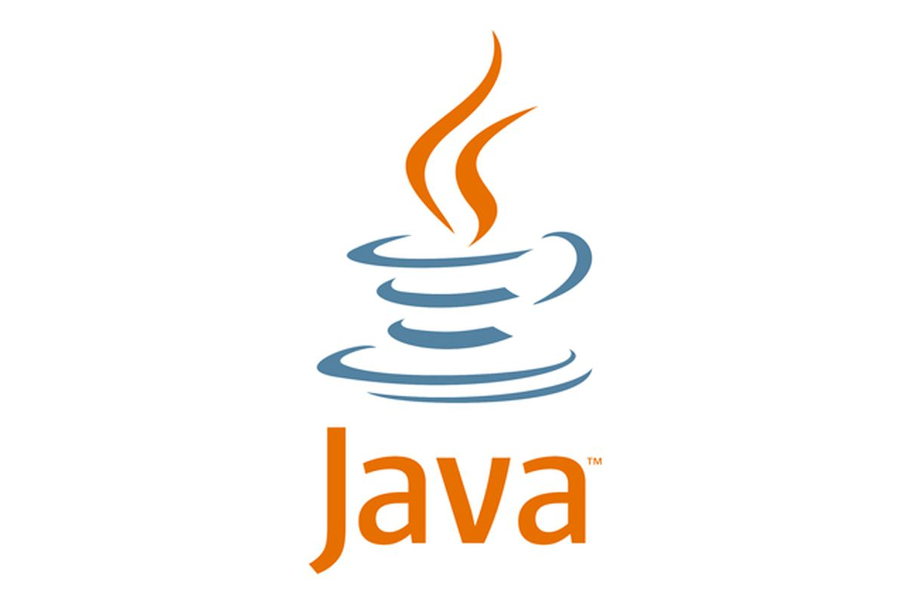
JAVA
Android phones run on Linux operating system. Java safeguards the native code from memory leaks and each platform in the Java language is used to compile for different functionalities in the Android development. Android apps can be developed using the different programming languages like Java, C, C++, HTML, python etc. There are so many new tools used for the mobile development like flow up, stetho, Jbel for android, Gradle please, android asset studio, leak canary, dry run, slides code highlighter, instabug, takt, android debug database, source tree, geny motion, vysor, android wifi ADB, find bugs, drawable optimizer, scalpel, block canary, nimble droid, methods count, android tool for Mac, DevKnox, JSONSchema2POJO, ADB IDEA, Key promoter, Fabric, Classyshark, APK DeGuard, and Cordova.

Slide 5
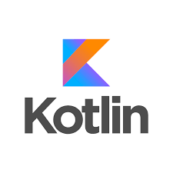
KOTLIN
Kotlin is a cross-platform programming language that may be used as an alternative to Java for Android App Development. Kotlin is much simpler for beginners to try as compared to Java and this Kotlin Android can also be used as an ‘entry point’ for Android App Development. Kotlin is sponsored by Google, announced as one of the official languages for Android Development in 2017. Kotlin programming language is multi-platform, i.e. easily executable on a Java Virtual Machine.

Slide 6
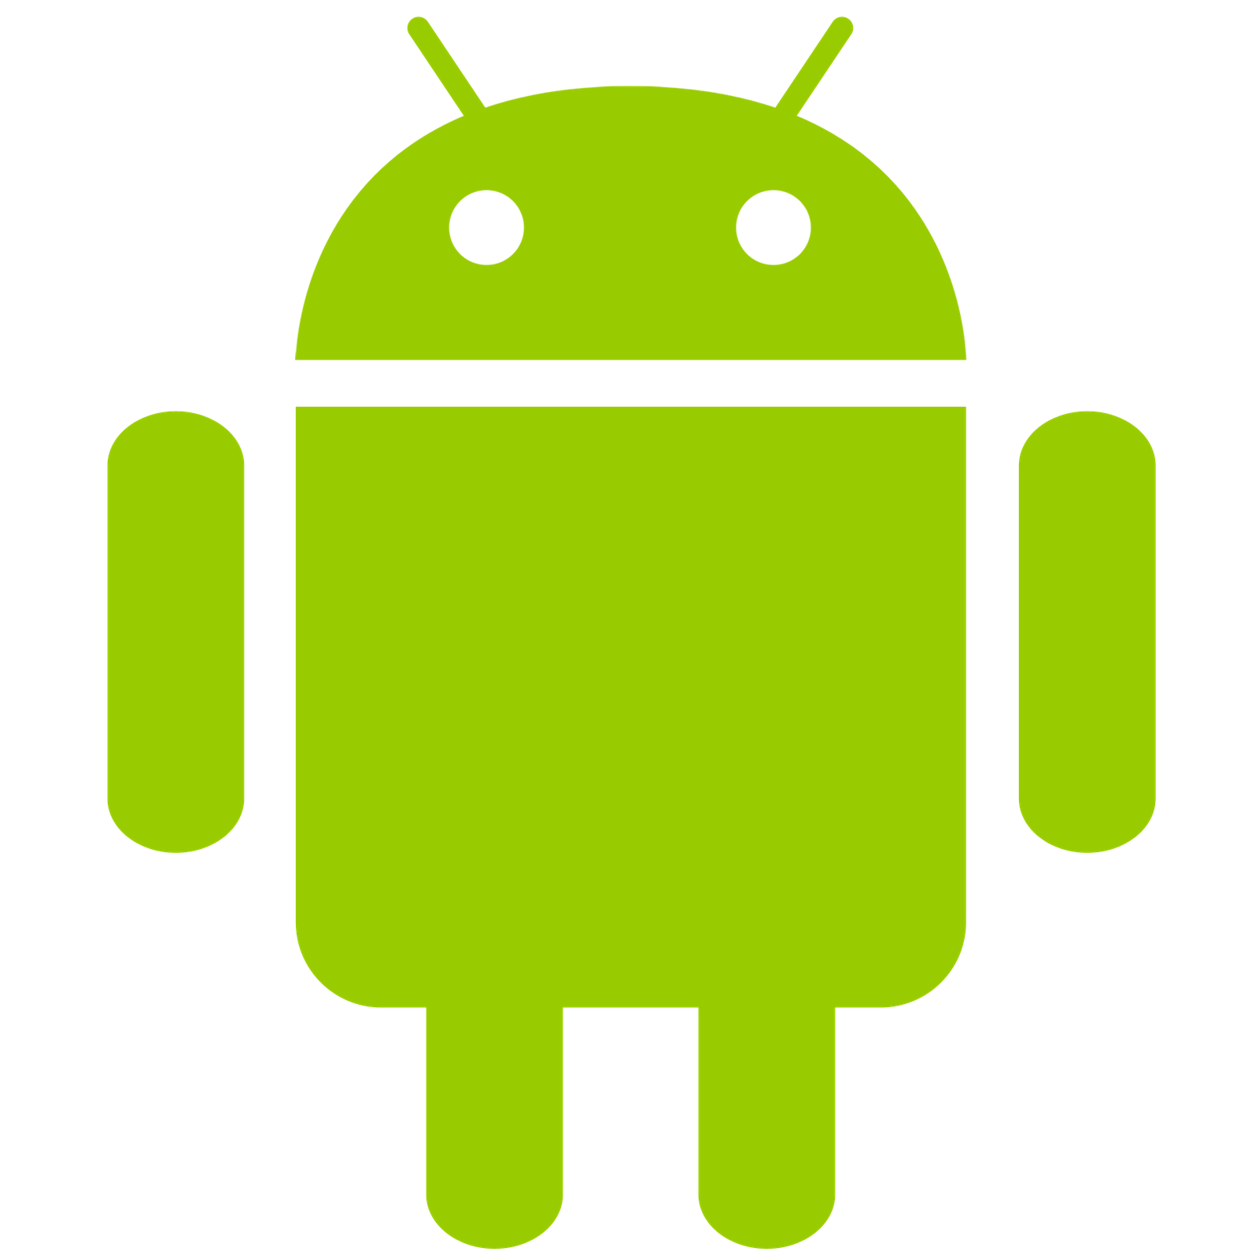
Android Developement
Android operating system is the largest installed base among various mobile platforms across the globe. Hundreds of millions of mobile devices are powered by Android in more than 190 countries of the world. It conquered around 71% of the global market share by the end of 2021, and this trend is growing bigger every other day. The company named Open Handset Alliance developed Android for the first time that is based on the modified version of the Linux kernel and other open-source software. Google sponsored the project at initial stages and in the year 2005, it acquired the whole company. In September 2008, the first Android-powered device was launched in the market. Android dominates the mobile OS industry because of the long list of features it provides. As a result, the market observes a sharp increase in the demand for developing Android mobile applications, and with that companies need smart developers with the right skill set. At first, the purpose of Android was thought of as a mobile operating system. However, with the advancement of code libraries and its popularity among developers of the divergent domain, Android becomes an absolute set of software for all devices like tablets, wearables, set-top boxes, smart TVs, notebooks, etc.

Slide 7
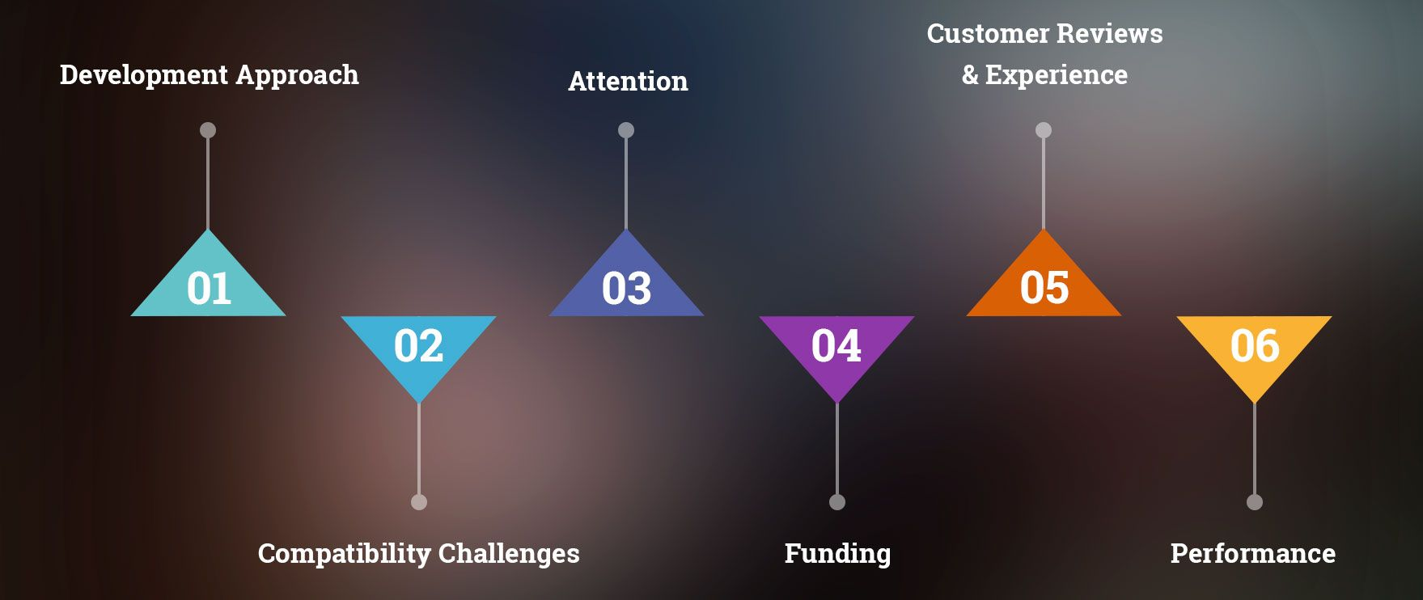
challenges FOR DEVELOPERS
Software Fragmentation
Mobile Device Fragmentation
Security Problems

Slide 8
UI LAYOUT

Slide 9
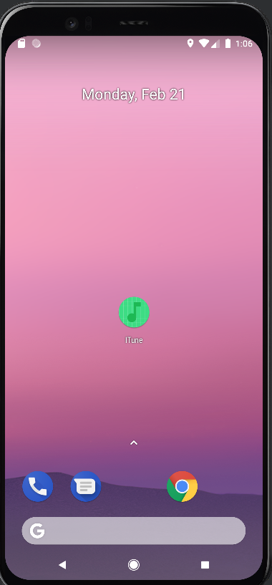
ITune Application

Slide 10
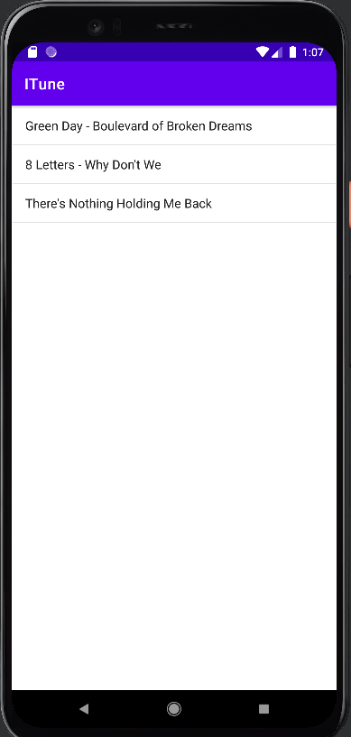
List of songs present in the internal storage

Slide 11
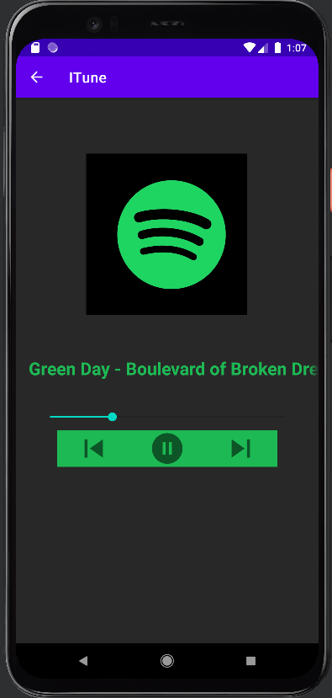
Playing the selected song

Slide 12
THANK YOU !!

